Slide 1
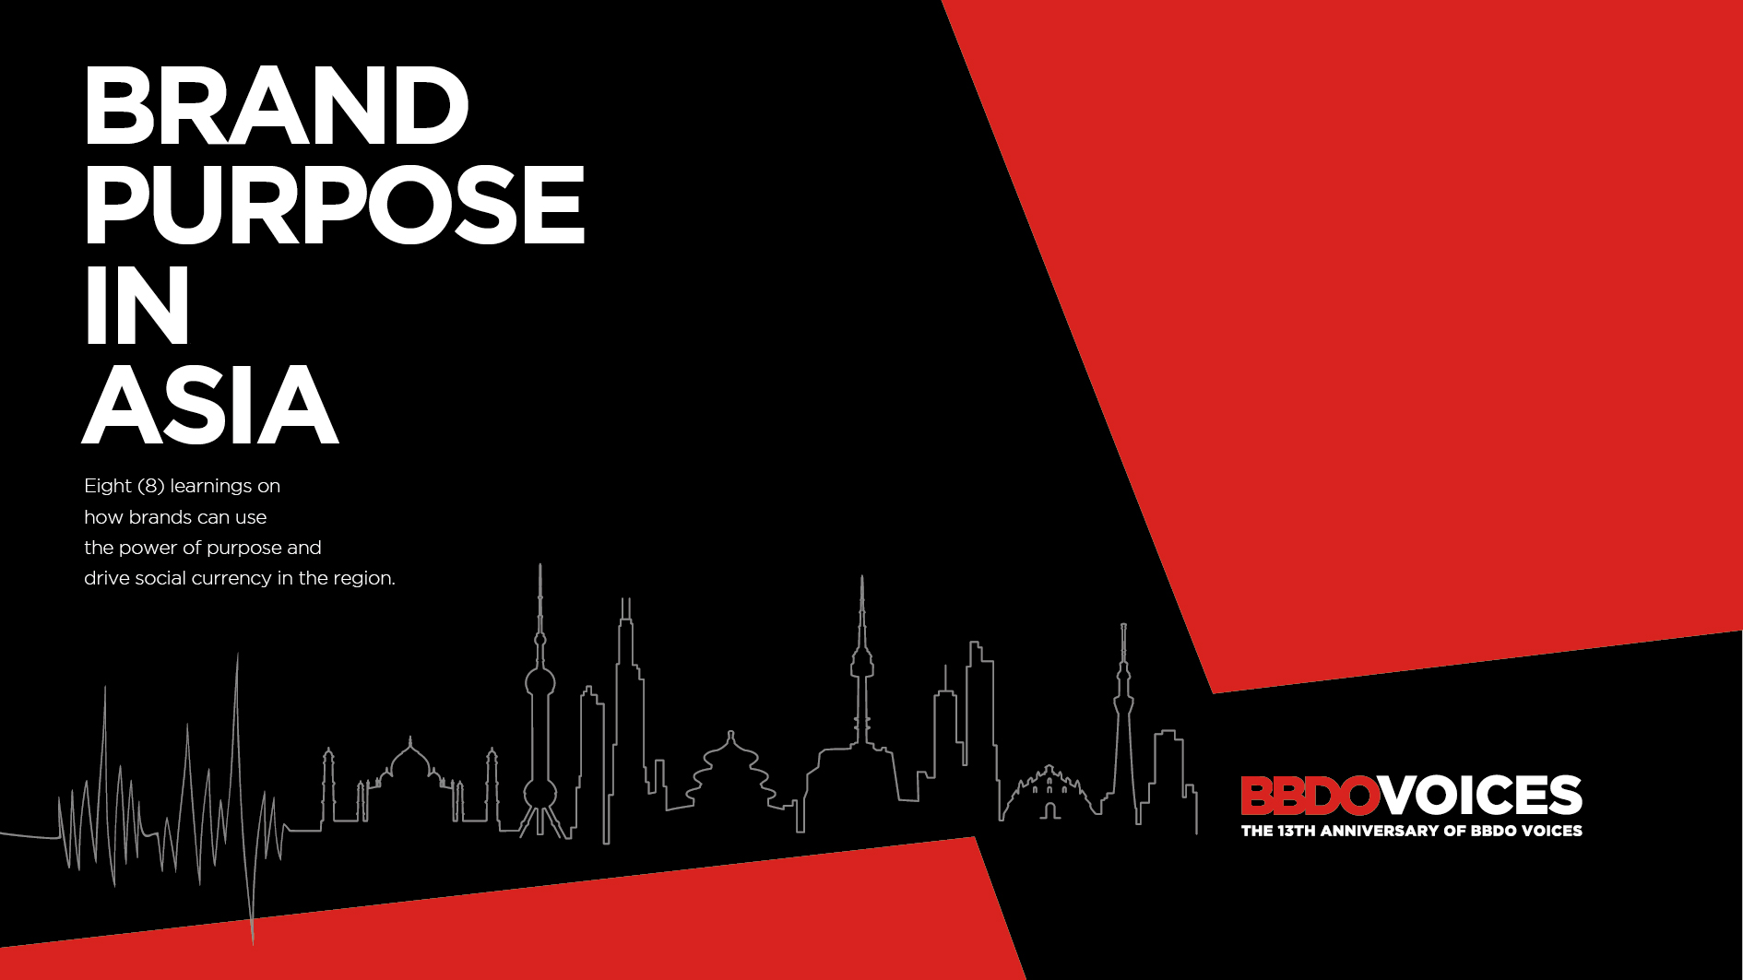

Slide 2
DEFINITION
PURPOSE is a reason for a brand to exist beyond making profit.
It combines the ambitions and beliefs that motivate the organization and the changes that it wants to make in the world.
_______
World Advertising Research Council (WARC)
BBDO

Slide 3

Because not enough research has been done to examine the relevance of
Brand Purpose in the Asian context.
WHY ANOTHER STUDY ON BRAND PURPOSE?
A lot of rich material has been written about Brand Purpose in recent years, but most of these studies have been carried out from the perspective of western markets and only a handful were written with a pure focus on Asia.
Oftentimes these studies focused on identifying the most relevant social topics to consumers in the region without investigating whether a brand positioning based on such topics would make a brand more appealing and distinctive to Asian consumers.
Considering Asia's diverse range of cultures, we also saw the need to better understand the nuances that exist within Asia – be it across countries or within – to enable marketers to adjust brand narratives.

Slide 4

HOW WE WENT ABOUT THE STUDY
RESEARCH METHODOLOGY
WHAT: Online survey using a structured questionnaire with closed and open-ended questions
WHO: The new generation of Asians (aged 18 to 45 years old)
WHERE:
  Mainland China
  South Korea
  Japan
  Thailand
  Philippines
  India
HOW MANY: N=300/country; N=1,800 in total
Fieldwork and data-processing carried out by
Pure Spectrum on behalf of BBDO.

Slide 5
LEARNING 1:
ASIA'S CONSUMERS ARE VERY RESPONSIVE TO BRAND PURPOSE, MAKING IT AN IMPORTANT POSITIONING STRATEGY THAT MARKETERS SHOULD TAKE ADVANTAGE OF IN THE REGION.
BBDO

Slide 6
ATTITUDES TOWARDS BRANDS
% WHO STRONGLY AGREE*
“I tend to sleep shop.”
“Brands help with
social approval”
“I’m function
driven”
“I appreciate purpose brands”
“I like the brands celebrities like”
“I’m price-sensitive”
I always stick
to the same brands
I rarely compare my current brand with alternatives
I like brands my friends talk
about
I want my friends to also like my brands
I spend more time researching the quality of products
I like brands that do good for society or the planet
I like brands that support the issues I care about
I like brands my favorite celebrities also like
I choose brands that are more affordable
I tend to be
loyal to brands
I love
I tend to use the same brands as my friends
The brands I use help me feel I belong
The technology of the products I use is important
to me
I don’t mind watching a boring ad if it highlights a product’s quality
I like brands that represent the same values I believe in
I only use brands celebrities
also use
I still believe what paid celebrities say about brands
I actively look for brands that are on
promotion
BASE: Total Respondents
*Measured on a 5-point agreement scale

Slide 7
IN ASIA, NEARLY HALF OF CONSUMERS SAY THEY HAVE RECENTLY CHOSEN BRANDS DUE TO THEIR SOCIAL PURPOSE.
WHICH OF THE FOLLOWING DID YOU BUY
IN THE PAST-3 MONTHS?
A brand with a discount
A brand with a great advertisement
It is worth noting, however, there is no brand purpose without an equally compelling narrative about the quality of the brand's products or services.
Among those who say they expect brands to have a social purpose: 6 out of 10 also chose a brand due to its high-quality products or services.
A brand that makes a positive impact on society
Net:
47%
A brand from a company with good values
A brand endorsed by someone famous
A brand offering high quality product/ service
BASE: Total Respondents

Slide 8
BRAND PURPOSE VS. OTHER CONTENT TYPES:
ESPECIALLY RELEVANT FOR ‘UPPER FUNNEL’ OBJECTIVES
Brand purpose is particularly powerful in helping a brand build quality brand awareness. It outperforms other types of content when it comes to getting brands noticed, forming positive impressions with audiences, and triggering curiosity among consumers.
WHAT KIND OF BRANDED CONTENT WILL MAKE YOU…
Product-related information
Content about brand purpose
Index vs.
Average for other Content Types
Price-related information
Content from celebrities
Content from influencers
Note: Index >100 (higher than average); <100 (lower than average)
Base: Total Respondents
Average for all content types

Slide 9
LEARNING 2:
ALTHOUGH PURPOSE-DRIVEN TOPICS VARY CONSIDERABLY BY COUNTRY, ONE TOPIC RESONATES STRONGLY ACROSS ALL MARKETS: ENVIRONMENT & SUSTAINABILITY.
BBDO

Slide 10
CONSUMERS ACROSS COUNTRIES WANT BRANDS TO CHAMPION SUSTAINABILITY
THE MOST.
WHAT TOPICS OR CAUSES
DO YOU WANT BRANDS TO CHAMPION?
(PLEASE CHOOSE 3 FROM THE LIST)
Environment/sustainability
Using natural/organic ingredients
Making products affordable for all
Promoting physical & mental health
Using local ingredients or material
When asked to nominate what causes brands should champion, environment-related themes came out on top.
Providing affordable products for the masses is immensely relevant to the everyday lives of many in the region, ranking high within Asian consumers’ definition of purpose.
Protecting clean water sources
Empowering women/equality
Driving diversity, equity & inclusion
Protecting animal rights/welfare
Paying the right amount of taxes
Helping to strengthen relationships
Promoting national pride
Fighting poverty
Advocating for quality education
Upholding family values
Paying own employees well
Supporting government priorities
Advocating LGBTQ acceptance
Upholding traditional values
Freedom of worship
BASE: Purpose-Driven Shoppers

Slide 11
TOP-5, BY COUNTRY
WHAT TOPICS OR CAUSES DO YOU WANT BRANDS TO CHAMPION?
Environment and sustainability themes are within the top-5 in all of the countries covered.
China
Thailand
Philippines
1
Environment/sustainability | 33%
Making products affordable for all | 24%
Using natural or organic ingredients | 24%
Social justice | 23%
Diversity, equality, and inclusivity | 21%
1
Environment/sustainability | 39%
Using natural or organic ingredients | 27%
Making products affordable for all | 25%
Promoting mental health | 22%
Social justice | 20%
1
Environment/sustainability | 42%
Making products affordable for all | 29%
Promoting physical & mental health | 27%
Using natural or organic ingredients | 26%
Using local ingredients or material | 23%
S. Korea
Japan
India
1
Environment/sustainability | 38%
Social justice | 31%
Diversity, equality, and inclusivity | 24%
Using local ingredients or material | 17%
Protecting clean water sources | 16%
Empowering women/equality | 25%
Promoting physical & mental health | 23%
Making products affordable for all | 22%
Promoting national pride | 21%
Environment/sustainability | 19%
1
Environment/sustainability | 31%
Using natural or organic ingredients | 29%
Using local ingredients or material | 25%
Promoting physical & mental health | 20%
Protecting clean water sources | 19%
5
BASE: Purpose-Driven Shoppers

Slide 12
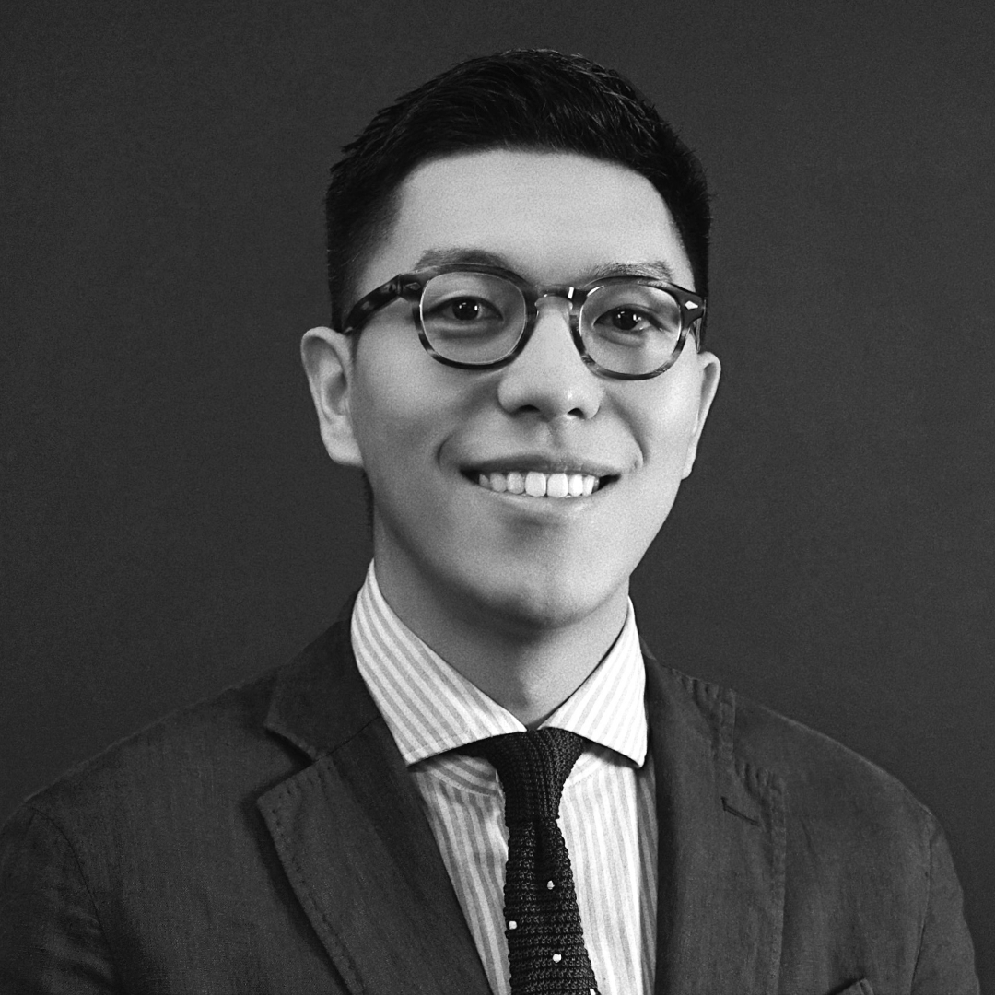
EXPERT VOICE
“Environmental problems and climate change concerns every single one of us. The recent record-breaking heat waves that spanned more than half of the land in China affected over 900 million people – more than the combined population of Europe. These extreme climate events are becoming increasingly common, and they add more urgency to taking action on these issues – brands have a clear role to play here.”
HARRY CHEN
Group Planning Director
BBDO CHINA

Slide 13
LEARNING 3:
THERE IS A CLEAR PATTERN FORMING –
THE LESS DEVELOPED AN ECONOMY IS,
THE MORE STRONGLY CONSUMERS WANT BRANDS ROOTED IN PURPOSE.
BBDO

Slide 14
TWO COUNTRIES
STAND OUT IN BEING
THE MOST INTERESTED
IN BRANDS THAT HAVE A PURPOSE: PHILIPPINES
AND INDIA.
ATTITUDES TOWARDS BRAND PURPOSE
% WHO STRONGLY AGREE* – BY COUNTRY
China
Thailand
Philippines
S. Korea
Japan
India
Consumers from these less developed economies look to brands the most to play a significant role in society.
Asia
Average
“I like brands that stand for the good of society or planet”
“I like brands that represent the same values I believe in”
“I like brands that support the issues I care about”
BASE: Total Respondents
*Measured on a 5-point agreement scale

Slide 15
ASIA’S “BRAND PURPOSE PARADOX”
ATTITUDES TOWARDS
BRAND PURPOSE
vs. ECONOMIC DEVELOPMENT
In Asia, there is a strong inverse correlation between a country's economic condition and its citizens' attitudes toward brand purpose.
The less robust an economy is (as measured by GDP per capita), the greater people’s desire for brands to contribute to society becomes. This is best presented in markets like the Philippines and India where citizens expect brands to fill gaps in society that governments often cannot.
In contrast, the more robust an economy is, i.e., Japan and Korea, the less likely people will look to brands and corporations to embody a purpose.
India
R² = 0.9201
Philippines
Thailand
China
I like brands that support
the issues I care about (% Strongly Agree)
South Korea
Japan
GDP per Capita (in US$)**
BASE: Total Respondents
*Measured on a 5-point agreement scale
**Source: World Bank

Slide 16
PHILIPPINES & INDIA:
PEOPLE NEED BRANDS TO ALLEVIATE THE URGENT CHALLENGES OF LIFE.
In such countries which are highly vulnerable to the effects of global warming, consumers need brands to champion sustainability. Moreover, citizens here also want brands to make products affordable for all, and help local communities thrive (e.g., via use of local ingredients, help on government initiatives, etc.).
Desired Brand Focus
PHILIPPINES
Desired Brand Focus
INDIA
Protecting clean water sources
Makes products affordable for all
Help government in nation-building agenda
Uses 100% local ingredients/
material
Environment/
sustainability
Uses natural ingredients
Uses 100% local ingredients/
material
Promotes good physical & mental health
Index vs. Asia Average
Index vs. Asia Average
Environment/
sustainability
Uses natural
ingredients
% Mentions*
% Mentions*
BASE: Purpose-Driven Shoppers
*as part of top-3 choices

Slide 17
THUS, CONSUMERS IN THESE MARKETS
ARE MORE LIKELY TO HAVE BOUGHT PURPOSE-DRIVEN BRANDS.
WHICH OF THE FOLLOWING DID YOU BUY
IN THE PAST-3 MONTHS? - TOTAL ASIA
BOUGHT A BRAND FOR ITS PURPOSE*
IN THE PAST-3 MONTHS – BY COUNTRY
A brand with a discount
China
A brand with a great advertisement
Thailand
A brand that makes a positive impact on society
Philippines
Net:
47%
A brand from a company with good values
S. Korea
Japan
A brand endorsed by someone famous
India
A brand offering high quality product/ service
Asia Average
*Net: Bought a ”brand that makes a positive impact on society” +
“brand from a company with good values” in p-3 months
Base: Total Respondents

Slide 18

EXPERT VOICE
“A nation throbbing with first world ambition is dampened by third world infrastructure. A large population of young India has to face resistance from old conservative mindset. Apathy of state towards bettering basic quality of life and lack of any cultural playbook that older generation can tap into to respond to new emerging narratives, compels Indians to look up to brands as change-makers! We expect brands to leverage their resources in making meaningful impact beyond sales. Brands can provide social sanction to new ideas, they can bridge the infrastructure gap, they can right any wrong that comes in the way of progress and thus become a catalyst to fulfilling our first world aspiration.”
SURAJA KISHORE
Chief Executive Officer
BBDO INDIA

Slide 19
LEARNING 4:
THE WEAK RESONANCE OF PURPOSE-DRIVEN BRANDS IN JAPAN & KOREA COMES FROM MEN. WOMEN IN THESE COUNTRIES LOOK TO BRANDS
AS ALLIES ON GENDER ISSUES.
BBDO

Slide 20
In Japan & Korea,
WOMEN WANT BRAND PURPOSE MUCH MORE THAN MEN.
ATTITUDES TOWARDS BRAND PURPOSE
% STRONGLY AGREE* – BY GENDER
Men
Women
Japan
In these countries, women are much more likely to embrace brands that are rooted in purpose-driven values than men.
This is especially true in Japan where women are 2x more likely than men to seek brands that embody a purpose.
“I like brands that stand for the good of society or planet”
“I like brands that represent the same values I believe in”
“I like brands that support the issues I care about”
S. Korea
“I like brands that stand for the good of society or planet”
“I like brands that represent the same values I believe in”
“I like brands that support the issues I care about”
Base: Total Respondents
*Measured on a 5-point agreement scale

Slide 21
The Gender Divide in Japan & Korea:
WHAT TOPICS/CAUSES DO YOU WANT BRANDS TO CHAMPION?
Top-3 Choices (in %)
Japan
S. Korea
Making products affordable for all
Promoting national pride
Paying own employees well
Promoting physical & mental health
Environment/sustainability
Social justice
Paying the right amount of taxes
Men
Using local ingredients or material
Helping to strengthen relationships
Women
Using natural/organic ingredients
Advocating for quality education
Empowering women/equality
Fighting poverty
Protecting clean water sources
Advocating LGBTQ acceptance
Driving diversity, equity & inclusion
Supporting government priorities
Protecting animal rights/welfare
Upholding family values
Upholding traditional religious values
Freedom of worship
BASE: Purpose-Driven Shoppers
*Note: as part of top-3 choices

Slide 22
JAPANESE & KOREAN WOMEN SEE BRANDS AS POTENTIAL ALLIES WHEN IT COMES TO WOMEN EMPOWERMENT ISSUES.
WHAT TOPICS OR CAUSES
DO YOU WANT BRANDS TO CHAMPION?
% who said ”Women Empowerment/Equality”
Men
Women
As the men in these countries are less keen on this issue, women are prompted to find support from other sources in society - including brands.
In fact, more women in Japan feel it is more urgent for brands to champion women empowerment/ equality (35%) than the environment (18%).
BASE: Purpose-Driven Shoppers
*Note - as part of top-3 choices

Slide 23
JAPANESE & KOREAN WOMEN ARE SEEING LESS SUPPORT FROM MALE COUNTERPARTS ON GENDER ISSUES.
PERSONAL BELIEFS ON GENDER ISSUES
% STRONGLY BELIEVE* – BY GENDER
Men
Women
“I believe ads should not show only women doing chores”
+30%
+104%
+42%
While there is a gender divide on the issue of gender equality across the region, this is especially more pronounced in Japan and Korea.
In these two countries, men care the least about gender equality.
“Ads should help women feel good about their bodies”
+28%
+141%
+57%
Base: Total Respondents
*Measured on a 5-point scale

Slide 24
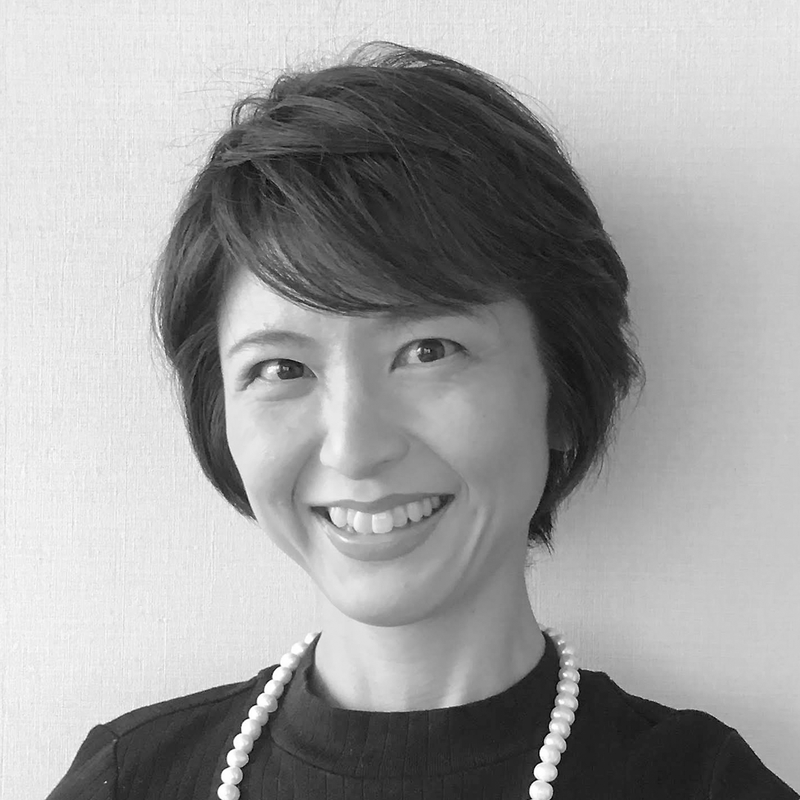
EXPERT VOICE
“Japan's gender gap index ranks 116th out of 146 countries, which is by far the lowest among developed countries. One of the main reasons for this is the income gap between men and women and the low ratio of women in management positions, which Japanese women expect companies (who own brands) to change. On the other hand, since men have not been suffering disadvantages in the gender gap in Japan, the survey results may have revealed that their interest in this topic is not as high as women’s. (Unfortunately!)”
KAORI YATSU
Head of Planning/D&I Officer
BBDO JAPAN

Slide 25
LEARNING 5:
ALTHOUGH JAPANESE MEN ARE LESS KEEN ABOUT BRAND PURPOSE, THEY WANT BRANDS
TO SUPPORT ISSUES THAT CAN HELP THEM FINANCIALLY DURING DIFFICULT TIMES.
BBDO

Slide 26
THE MEN IN JAPAN:
FIRST WORLD CONSUMERS ENCOUNTERING THIRD WORLD ISSUES.
WHAT TOPICS OR CAUSES
DO YOU WANT BRANDS TO CHAMPION?
A Signficant Difference Between Men vs. Women - JAPAN
Men
Women
While Japanese men do not demonstrate interest in brand purpose in general, they want brands to help them deal with challenging financial matters, which we also see is common among emerging market consumers from the Philippines and India.
In fact, making products affordable for all is the top topic Japanese men want brands to champion. In other countries, men prioritize the urgency of environment/sustainability.
“Making products affordable for all”
“Paying own employees well”
BASE: Purpose-Driven Shoppers
*Note - as part of top-3 choices

Slide 27
LEARNING 6:
RECENT DEVELOPMENTS IN ASIA HAVE USHERED A NEW ERA OF BRAND NATIONALISM AMONG THE MEN IN THE MIDST OF THE GEOPOLITICAL STORM.
BBDO

Slide 28
THE RISE OF NATIONAL PRIDE AND THE POTENTIAL ROLE BRANDS CAN PLAY IN STOKING IT.
% WHO SAY THEY WANT BRANDS
TO “PROMOTE NATIONAL PRIDE”
Total Asia
China
Consumers in countries afflicted by geopolitical tensions in the region are more likely to want brands to promote national pride.
This is reinforced by brands in some parts of the region (e.g., China) that embrace a purpose narrative that celebrates a newfound sense of ascendancy and patriotism.
Thailand
Philippines
S. Korea
Japan
India
BASE: Purpose-Driven Shoppers
*Note - as part of top-3 choices

Slide 29
IN CHINA AND JAPAN,
THE DESIRE FOR ‘PATRIOTIC BRANDS’ CENTERS AROUND MEN.
% WHO SAY THEY WANT BRANDS
TO “PROMOTE NATIONAL PRIDE”
Signficant Difference Between Men vs. Women
Men
Women
In China, promoting national pride is the #3 brand purpose that men want brands to champion.
Among Japanese men, this topic is even more compelling than the theme of environment and sustainabiity.
Women in these two countries, on the other hand, are less concerned with such nationalistic brand rhetoric.
China
Japan
BASE: Purpose-Driven Shoppers

Slide 30
LEARNING 7:
WHEN IT COMES TO THE POTENTIAL FOR
BRAND PURPOSE MESSAGING AROUND
LGBTQ ADVOCACY, THE SITUATION IN ASIA IS HIGHLY NUANCED.
BBDO

Slide 31
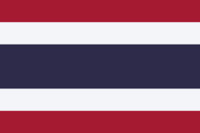
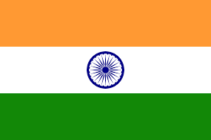

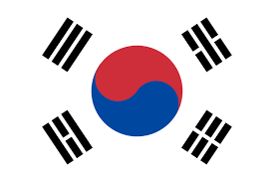
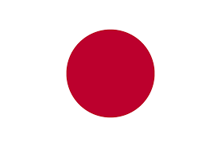
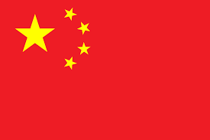
THE ASIAN REGION CAN BE BUCKETED INTO FOUR (4) WHEN IT COMES TO
OPENNESS TO LGBTQ ISSUES & ADVOCACY.
1
2
3
4
THE ACTIVE ADVOCATES.
A country that already embraces LGBTQ openness, and want brands to advocate for it
even more.
THE PASSIVE SUPPORTERS.
Countries that already accepts the
LGBTQ community, but where people do not feel brands need to advocate for it actively.
THE SYMPATHETIC
NICHE.
Countries where the LGBTQ community is not fully accepted, but a few (e.g., women in Japan) want brands to support it.
THE
HESITATORS.
Countries that do not embrace the LGBTQ community, and also do not want brands to
advocate for it.
Thailand
India
Philippines
S. Korea
Japan
China

Slide 32
THE ACTIVE ADVOCATES:
THAI CONSUMERS
ACCEPTANCE & ADVOCACY INDEX:
LGBTQ EQUALITY
Asia
Thailand
Consumers in Thailand accept LGBTQ communities more than the average in the region.
Thai consumers also want brands to advocate for this cause more than those in other Asian countries.
Thus, in this market, brands have an opportunity to join the fight with consumers.
Index vs. Asia
Asia
Average
ACCEPTANCE
“I believe it’s ok for ads to should show gay, lesbian & other groups more openly”
(Base: Total)
ADVOCACY
“I want brands to
advocate for LGBTQ equality or acceptance”
(Base: Purpose Shoppers)
Note: Asia = 100

Slide 33
THE PASSIVE SUPPORTERS:
INDIAN AND FILIPINO CONSUMERS
ACCEPTANCE & ADVOCACY INDEX:
LGBTQ EQUALITY
Asia
India
Philippines
Indians and Filipinos – despite being rooted in conserative religions – actually demonstrate higher than average acceptance for the LGBTQ community.
The consumer desire for brands to advocate this cause is weaker than average in these countries - either because they no longer consider it an issue and no longer need brand advocacy, or because they see more urgent issues in their developing economies.
Either way, brands still have an opportunity to reinforce change in these open-minded markets.
Index vs. Asia
Asia
Average
ACCEPTANCE
“I believe it’s ok for ads to should show gay, lesbian & other groups more openly”
(Base: Total)
ADVOCACY
“I want brands to
advocate for LGBTQ equality or acceptance”
(Base: Purpose Shoppers)
Note: Asia = 100

Slide 34
THE
SYMPATHETIC NICHE:
JAPAN AND KOREA
ACCEPTANCE & ADVOCACY INDEX:
LGBTQ EQUALITY
Asia
S. Korea
Japan
The percentage of consumers who accept the openness of the LGBTQ community is still quite low in Japan and Korea.
Nevertheless, progressive supporters of the community – while fewer than in other countries – are very vocal, and really want brands to support it actively. These offer opportunities for counter-culture brands to stand with courage in support of LGBTQ communities.
Index vs. Asia
Asia
Average
ACCEPTANCE
“I believe it’s ok for ads to should show gay, lesbian & other groups more openly”
(Base: Total)
ADVOCACY
“I want brands to
advocate for LGBTQ equality or acceptance”
(Base: Purpose Shoppers)
Note: Asia = 100

Slide 35
THE
HESITATORS:
CHINA
ACCEPTANCE & ADVOCACY INDEX:
LGBTQ EQUALITY
Asia
China
There is still a lot of resistance to LGBTQ openness in the Chinese market in general. As such, the desire to have brands champion this issue is weaker than the regional average.
Brands and consumers advocating this issue need to contend with conservative legal/regulatory barriers to open expression in marketing and communications.
Index vs. Asia
Asia
Average
ACCEPTANCE
“I believe it’s ok for ads to should show gay, lesbian & other groups more openly”
(Base: Total)
ADVOCACY
“I want brands to
advocate for LGBTQ equality or acceptance”
(Base: Purpose Shoppers)
Note: Asia = 100

Slide 36
REGARDLESS OF THE LEVEL OF LGBTQ ACCEPTANCE & ADVOCACY, IT IS CLEAR THAT
THE YOUTH OF ASIA WILL LEAD THE WAY.
18-25 year olds
26-34 year olds
35-45 year olds
China
Philippines
Thailand
S. Korea
Japan
India
Note: Country Average = 100
Country Average

Slide 37
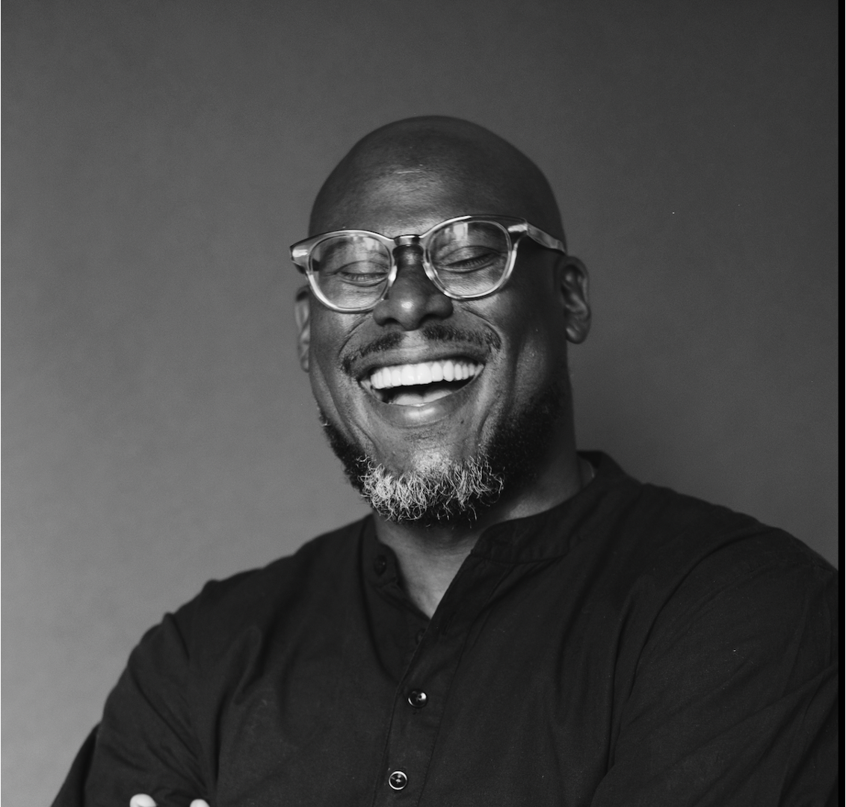
EXPERT VOICE
“We live in an increasingly diverse world. As global demographics shift, it is important for brands to adopt an inclusive, diverse, and intersectional approach to consumer engagement as part of their business growth strategy. The alternative is a brand that will slowly become less relevant. We know that Gen-Z consumers are the most accepting consumer segment as it relates to the LGBTQ+ community, and this study demonstrates how mission-critical it is for brands to align themselves in advocating for this community as well.”
JASON ROSARIO
Chief Diversity, Equity, & Inclusion Officer
BBDO WORLDWIDE

Slide 38
LEARNING 8:
CONSUMERS DO NOT SEEK A SENSE OF PURPOSE FROM BRANDS ONLY. THEY ALSO LOOK FOR IT FROM THE COMPANIES BEHIND THE BRANDS.
BBDO

Slide 39
THE IMPORTANCE OF THE ROLE OF CORPORATE BRAND IMAGE IN DRIVING PURCHASE CANNOT BE DISCOUNTED.
WHEN YOU BUY A BRAND,
HOW OFTEN DO YOU THINK ABOUT
THE COMPANY BEHIND IT?
About 7 in 10 Asian consumers think about the company behind the brand they purchase “all the time” or “most of the time.”
BASE: Total Respondents

Slide 40
WHEN YOU THINK ABOUT
THE COMPANY BEHIND A BRAND:
WHAT QUALITIES
MATTER MOST TO YOU?
AND A COMPELLING CORPORATE IMAGE IS LARGELY DRIVEN BY HAVING AN ASSOCIATED PURPOSE.
Reputation on Product Quality
Its Impact on the Country
Its Impact on Environment
Net:
39%
Adding up the items related to purpose is roughly equivalent to the reputation for product quality. It shows that a company’s purpose is becoming nearly as important as its reputation on product quality.
If it Helps Poor Consumers
The Causes it Supports
Technological Prowess
Reputation of its Leaders
Financial Stability/Scale
History or Heritage
Others
BASE: Total Who Think about Companies Behind Brands (All, Most, Some of the Time)
*Less than 0.5%

Slide 41
WHEN YOU THINK ABOUT
THE COMPANY BEHIND A BRAND:
WHAT QUALITIES
MATTER MOST TO YOU?
ONCE AGAIN, DEVELOPING ECONOMIES ARE THE MOST PARTICULAR ABOUT A CORPORATION’S REPUTATION.
% Who Mentioned Purpose-Related Attributes
India and the Philippines have the most discerning consumers when it comes to corporate entities behind brands.
In both countries, there is a big interest in how the company impacts the country’s development (20% and 14% for China and India, respectively). Environmental impact is also a key topic for both markets (14% and 11%, respectively).
Asia
Average
BASE: Total Who Think about Companies Behind Brands (All, Most, Some of the Time)

Slide 42

EXPERT VOICE
“Consumers appreciate the efforts of companies in nation-building, especially in third-world countries such as ours where the government is challenged on many fronts. Patriarch companies such as Ayala, San Miguel and SM continue to support with efforts in infrastructure, sustainability, agriculture, healthcare, education and disaster response.”
FRANCINE KAHN-GONZALEZ
Chief Executive Officer
BBDO GUERRERO

Slide 43
IN SUMMARY:
WHAT DO THESE TRENDS MEAN FOR THE FUTURE OF BRANDS AND MARKETING?
BBDO

Slide 44
CLIMATE CHANGE TO LIKELY SPEED UP THE IMPORTANCE OF BRAND PURPOSE. As the effects of global warming intensifies, more consumers will look to brands to embrace a sense of urgency and be part of the solution rather than the problem When this happens, brand purpose will significantly impact brand and customer relations much more than now.
BRAND PURPOSE WILL BECOME ´DE RIGUEUR` FOR MARKETERS AS GEN Z ASIAN CONSUMERS COME OF AGE AND TAKE OVER SOCIETY. While traditional mindsets and narratives still persist in the region, those under 25 demonstrate progressive voices on issues like LGBT+ acceptance and advocacy. They will expect brands to be their voice, and brands that do not stand for a social purpose will lose social currency.
BRANDS WILL INCREASINGLY HAVE THE SAME ACCOUNTABILITY AS QUASI-GOVERNMENT BODIES. This is especially true in the developing regions of Asia where citizens already expect brands to step up and fill gaps which public governance systems often cannot. In this sense, consumers there will continue to expect brands to embrace the same agenda as governments.
BRAND PURPOSE IN ASIA WILL HAVE ASIAN CHARACTERSTICS. Brand purpose in Asia can never exist in a vacuum. A brand’s purpose – to be relevant to the region’s consumers – will always need to be rooted in what the product or service is supposed to functionally deliver. It also needs to be supplemented by rational/functional content along the customer journey.

Slide 45
CREDITS
is a project of
the BBDO Asia Planning Council
VOICES
Hans Lopez-Vito
BBDO Asia
Suraja Kishore
BBDO India
Kaori Yatsu
BBDO Japan
Harry Chen
BBDO Shanghai
Yun-Kyung Ha
BBDO Korea
Daisuke Sasaki
I&S BBDO Japan
Leonardo Bai
BBDO Beijing
Roshan Nandwani
BBDO Guerrero
Prasit Kunanuphanchai
BBDO Thailand
Roy Chen
BBDO Taiwan
Catherine Zhu
INTERONE China

Slide 46


